Slide 1




Advanced Graph Algorithms
Spanning Trees, Shortest Paths, Strongly Connected Components, Bi-Connectivity, Max Flow
Advanced Graph Algorithms
SoftUni Team
Technical Trainers
Software University
http://softuni.bg

Slide 2

Table of Contents
Minimum Spanning Tree (MST)
Prim and Kruskal Algorithms
Lab: Implement Kruskal's Algorithm
Shortest Paths: Dijkstra's Algorithm
Lab: Implementing Dijkstra's Algorithm
Bellman-Ford Algorithm
Detecting Negative-Weight Cycles
Floyd-Warshall All Pairs Algorithm

Slide 3

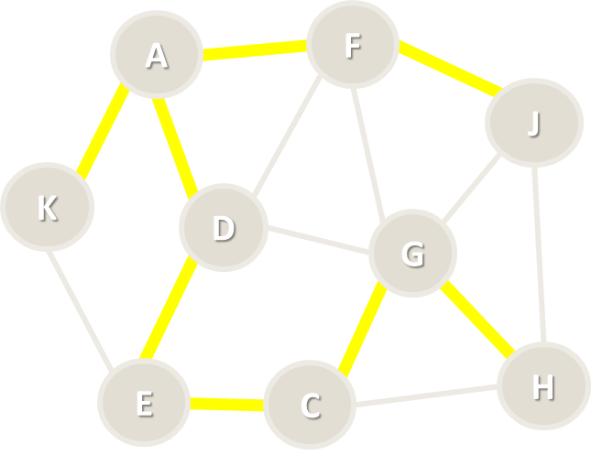
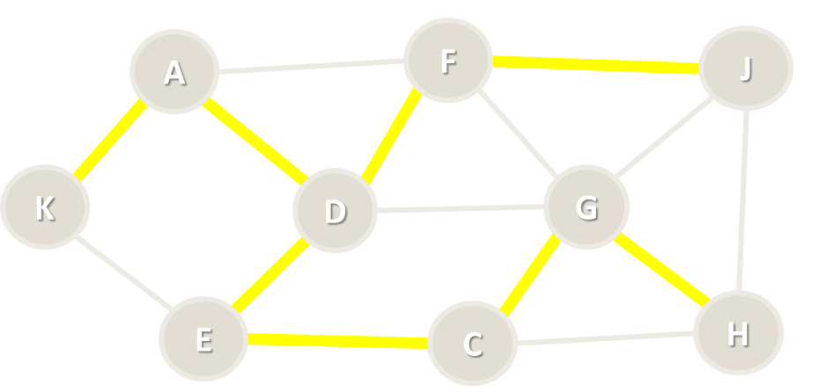
Minimum Spanning Tree (MST)

Slide 4
Spanning Tree
Spanning tree
Subgraph without cycles (tree)
Connects all vertices together
All connected graphs have a spanning tree
All undirected graphs have spanning forest
A
F
J
K
D
G
H
E
C

Slide 5

Minimum Spanning Tree (MST)
Minimum spanning tree (MST)
Weight <= weight(all other spanning trees)
First used in electrical networks
Minimal cost of wiring
17
F
14
A
J
10
6
13
11
16
K
D
33
G
26
12
4
9
20
E
14
22
H
C

Slide 6
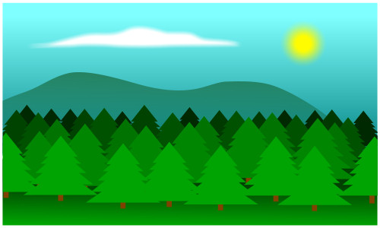
Minimum Spanning Forest (MSF)
Minimum spanning forest
Set of all minimum spanning trees (when the graph is not connected)
L
8
7
B
10
I
17
F
14
A
J
10
6
13
11
16
K
D
33
G
26
12
4
9
20
E
14
C
22
H

Slide 7
Kruskal's Algorithm
H
8
7
G
10
I
A
5
C
7
E
4
9
20
8
12
B
2
D
F

Slide 8
Kruskal's Algorithm
Create a forest F holding all graph vertices and no edges
Create a set S holding all edges in the graph
While S is non-empty
Remove the edge e with min weight from S
If e connects two different trees
Add e to the forest
Join these two trees into a single tree
The graph may not be connected
H
8
7
G
10
I
A
5
C
7
E
4
9
20
8
12
B
2
D
F

Slide 9
Kruskal's Algorithm – Step #1
Start from forest holding all vertices and no edges
S = all edges, ordered by weight
F = { }
S = {BD=2, AB=4, AC=5, CE=7, HI=7, DE=8, GH=8, AD=9, GI=10, EF=12, CD=20}
A
5
C
7
E
H
4
9
20
8
8
7
12
2
D
F
G
10
I
B

Slide 10
Kruskal's Algorithm – Step #2
Take the smallest edge BD = 2
The edge BD connects different trees → add it to the forest
F = {BD=2}
S = {AB=4, AC=5, CE=7, HI=7, DE=8, GH=8, AD=9, GI=10, EF=12, CD=20}
A
5
C
7
E
H
4
9
20
8
8
7
12
2
D
F
G
10
I
B

Slide 11
Kruskal's Algorithm – Step #3
Take the smallest edge AB = 4
The edge AB connects different trees → add it to the forest
F = {BD=2, AB=4}
S = {AC=5, CE=7, HI=7, DE=8, GH=8, AD=9, GI=10, EF=12, CD=20}
A
5
C
7
E
H
4
9
20
8
8
7
12
2
D
F
G
10
I
B

Slide 12
Kruskal's Algorithm – Step #4
Take the smallest edge AC = 5
The edge AC connects different trees → add it to the forest
F = {BD=2, AB=4, AC=5}
S = {CE=7, HI=7, DE=8, GH=8, AD=9, GI=10, EF=12, CD=20}
A
5
C
7
E
H
4
9
20
8
8
7
12
2
D
F
G
10
I
B

Slide 13
Kruskal's Algorithm – Step #5
Take the smallest edge CE = 7
The edge CE connects different trees → add it to the forest
F = {BD=2, AB=4, AC=5, CE=7}
S = {HI=7, DE=8, GH=8, AD=9, GI=10, EF=12, CD=20}
A
5
C
7
E
H
4
9
20
8
8
7
12
2
D
F
G
10
I
B

Slide 14
Kruskal's Algorithm – Step #6
Take the smallest edge HI = 7
The edge CE connects different trees → add it to the forest
F = {BD=2, AB=4, AC=5, CE=7, HI=7}
S = {DE=8, GH=8, AD=9, GI=10, EF=12, CD=20}
A
5
C
7
E
H
4
9
20
8
8
7
12
2
D
F
G
10
I
B

Slide 15
Kruskal's Algorithm – Step #7
Take the smallest edge DE = 8
The edge DE causes a cycle (connects the same tree) → skip it
F = {BD=2, AB=4, AC=5, CE=7, HI=7}
S = {GH=8, AD=9, GI=10, EF=12, CD=20}
A
5
C
7
E
H
4
9
20
8
8
7
12
2
D
F
G
10
I
B

Slide 16
Kruskal's Algorithm – Step #8
Take the smallest edge GH = 8
The edge GH connects different trees → add it to the forest
F = {BD=2, AB=4, AC=5, CE=7, HI=7, GH=7}
S = {AD=9, GI=10, EF=12, CD=20}
A
5
C
7
E
H
4
9
20
8
8
7
12
2
D
F
G
10
I
B

Slide 17
Kruskal's Algorithm – Step #9
Take the smallest edge AD = 9
The edge AD causes a cycle (connects the same tree) → skip it
F = {BD=2, AB=4, AC=5, CE=7, HI=7, GH=7}
S = {GI=10, EF=12, CD=20}
A
5
C
7
E
H
4
9
20
8
8
7
12
2
D
F
G
10
I
B

Slide 18
Kruskal's Algorithm – Step #10
Take the smallest edge GI = 10
The edge GI causes a cycle (connects the same tree) → skip it
F = {BD=2, AB=4, AC=5, CE=7, HI=7, GH=7}
S = {EF=12, CD=20}
A
5
C
7
E
H
4
9
20
8
8
7
12
2
D
F
G
10
I
B

Slide 19
Kruskal's Algorithm – Step #11
Take the smallest edge EF = 12
The edge EF connects different trees → add it to the forest
F = {BD=2, AB=4, AC=5, CE=7, HI=7, GH=7, EF=12}
S = {CD=20}
A
5
C
7
E
H
4
9
20
8
8
7
12
2
D
F
G
10
I
B

Slide 20
Kruskal's Algorithm – Step #12
Take the smallest edge CD = 20
The edge CD causes a cycle (connects the same tree) → skip it
F = {BD=2, AB=4, AC=5, CE=7, HI=7, GH=7, EF=12}
S = { } → stop the algorithm
A
5
C
7
E
H
4
9
20
8
8
7
12
2
D
F
G
10
I
B

Slide 21
Kruskal's Algorithm – Pseudo Code
foreach v ∈ graph edges
parent[v] = v
foreach edge {u, v} ordered by weight(u, v)
var rootU = FindRoot(u)
var rootV = FindRoot[v]
if rootU ≠ rootV
print edge {u, v}
parent[rootU] = rootV
FindRoot(node)
while (parent[node] ≠ node)
node = parent[node]
return node
Time complexity: O(|E| * log* |E|)
See http://visualgo.net/ufds.html

Slide 22
Disjoint Sets Optimization
FindRoot(node)
var root = node
while (parent[root] ≠ root)
root = parent[root]
// Optimize the path to root
// Attach each path node directly to the root
while (node != root)
var oldParent = parent[node]
parent[node] = root
node = oldParent
return root

Slide 23
Kruskal's Algorithm
A
5
C
7
E
H
4
9
20
8
8
7
12
2
D
F
G
10
I
B
Live Demo

Slide 24
Prim's Algorithm
H
8
7
G
10
I
A
5
C
7
E
4
9
20
8
12
B
2
D
F

Slide 25
Prim's Algorithm
Given a graph G(V, E) find the minimum spanning forest T(V', E')
Attach to the tree T the starting node
While smallest edge exists
Attach to T the smallest possible edge from G without creating a cycle in T
Use the smallest edge (u, v), such that u ∈ T and v ∉ T
Start the Prim's algorithm many times from all nodes from G still not in T
H
8
7
G
10
I
A
5
C
7
E
4
9
20
8
12
B
2
D
F

Slide 26
Prim's Algorithm – Step #1
Start from the initial node A
Enqueue all edges from A to other graph nodes: AB, AC, AD
Spanning tree = {A}
Priority queue = {AB = 4}, {AC = 5}, {AD = 9}
A
5
C
7
E
H
4
9
20
8
8
7
12
2
D
F
G
10
I
B

Slide 27
Prim's Algorithm – Step #2
Dequeue the shortest edge {AB = 4} and add it to the tree
Enqueue all edges from B to other graph nodes: BD
Spanning tree = {AB = 4}
Priority queue = {BD = 2}, {AC = 5}, {AD = 9}
A
5
C
7
E
H
4
9
20
8
8
7
12
2
D
F
G
10
I
B

Slide 28
Prim's Algorithm – Step #3
Dequeue the shortest edge {BD = 2} and add it to the tree
Enqueue all edges from D to other graph nodes: DC, DE
Spanning tree = {AB = 4}, {BD = 2}
Priority queue = {AC = 5}, {DE = 8}, {AD = 9}, {CD = 20}
A
5
C
7
E
H
4
9
20
8
8
7
12
2
D
F
G
10
I
B

Slide 29
Prim's Algorithm – Step #4
Dequeue the shortest edge {AC = 5} and add it to the tree
Enqueue all edges from C to other graph nodes: CE
Spanning tree = {AB = 4}, {BD = 2}, {AC = 5}
Priority queue = {CE = 7}, {DE = 8}, {AD = 9}, {CD = 20}
A
5
C
7
E
H
4
9
20
8
8
7
12
2
D
F
G
10
I
B

Slide 30
Prim's Algorithm – Step #5
Dequeue the shortest edge {CE = 7} and add it to the tree
Enqueue all edges from E to other graph nodes: EF
Spanning tree = {AB = 4}, {BD = 2}, {AC = 5}, {CE = 7}
Priority queue = {DE = 8}, {AD = 9}, {EF = 12}, {CD = 20}
A
5
C
7
E
H
4
9
20
8
8
7
12
2
D
F
G
10
I
B

Slide 31
Prim's Algorithm – Step #6
Dequeue the shortest edge {DE = 8}
It would create a loop in the spanning tree → skip it
Spanning tree = {AB = 4}, {BD = 2}, {AC = 5}, {CE = 7}
Priority queue = {AD = 9}, {EF = 12}, {CD = 20}
A
5
C
7
E
H
4
9
20
8
8
7
12
2
D
F
G
10
I
B

Slide 32
Prim's Algorithm – Step #7
Dequeue the shortest edge {AD = 9}
It would create a loop in the spanning tree → skip it
Spanning tree = {AB = 4}, {BD = 2}, {AC = 5}, {CE = 7}
Priority queue = {EF = 12}, {CD = 20}
A
5
C
7
E
H
4
9
20
8
8
7
12
2
D
F
G
10
I
B

Slide 33
Prim's Algorithm – Step #8
Dequeue the shortest edge {EF = 12} and add it to the tree
Enqueue all edges from F to other graph nodes: no such edges
Spanning tree = {AB = 4}, {BD = 2}, {AC = 5}, {CE = 7}, {EF = 12}
Priority queue = {CD = 20}
A
5
C
7
E
H
4
9
20
8
8
7
12
2
D
F
G
10
I
B

Slide 34
Prim's Algorithm – Step #9
Dequeue the shortest edge {CD = 20}
It would create a loop in the spanning tree → skip it
Spanning tree = {AB = 4}, {BD = 2}, {AC = 5}, {CE = 7}, {EF = 12}
Priority queue = { } → stop the algorithm
A
5
C
7
E
H
4
9
20
8
8
7
12
2
D
F
G
10
I
B

Slide 35
Prim's Algorithm – Step #10
Start from the initial node G
Enqueue all edges from G to other graph nodes: GH, GI
Spanning tree = {AB, BD, AC, CE, EF}, {G}
Priority queue = {GH = 8}, {GI = 10}
A
5
C
7
E
H
4
9
20
8
8
7
12
2
D
F
G
10
I
B

Slide 36
Prim's Algorithm – Step #11
Dequeue the shortest edge {GH = 8} and add it to the tree
Enqueue all edges from H to other graph nodes: HI
Spanning tree = {AB, BD, AC, CE, EF}, {GH = 8}
Priority queue = {HI = 7}, {GI = 10}
A
5
C
7
E
H
4
9
20
8
8
7
12
2
D
F
G
10
I
B

Slide 37
Prim's Algorithm – Step #12
Dequeue the shortest edge {HI = 7} and add it to the tree
Enqueue all edges from I to other graph nodes: no such edges
Spanning tree = {AB, BD, AC, CE, EF}, {GH = 8}, {HI = 7}
Priority queue = {GI = 10}
A
5
C
7
E
H
4
9
20
8
8
7
12
2
D
F
G
10
I
B

Slide 38
Prim's Algorithm – Step #13
Dequeue the shortest edge {GI = 7} and add it to the tree
It would create a loop in the spanning tree → skip it
Spanning tree = {AB, BD, AC, CE, EF}, {GH = 8}, {HI = 7}
Priority queue = { } → stop the algorithm
A
5
C
7
E
H
4
9
20
8
8
7
12
2
D
F
G
10
I
B

Slide 39
Prim's Algorithm (with Priority Queue)
var spanningTreeNodes = Ø
foreach (v ϵ graphVertices)
if (v ∉ spanningTreeNodes)
Prim(v)
Prim(startNode)
spanningTreeNodes ← startNode
var priorityQueue = Ø
priorityQueue ← childEdges(startNode)
while (priorityQueue is not empty)
smallestEdge = priorityQueue.ExtractMin()
if (smallestEdge connects tree node with non-tree node)
print smallestEdge
spanningTreeNodes ← smallestEdge.nonTreeNode
priorityQueue ← childEdges(smallestEdge.nonTreeNode)
Time complexity: O(|E| * log |E|)
1
8
7
4
10
7
0
5
8
7
6
4
9
20
8
12
2
3
2
5

Slide 40
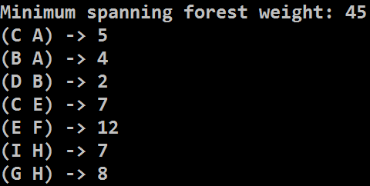
Prim's Algorithm with Priority Queue
H
8
7
G
10
I
A
5
C
7
E
4
9
20
8
12
B
2
D
F
Live Demo

Slide 41
Prim's Algorithm – Pseudo Code
var usedNodes = Ø;
for (v = 0…n-1)
if (not usedNodes[v])
Prim(v);
Prim(startNode)
usedNodes ← startNode
var edgeNode[0 … n-1]
var nearest[0 … n-1]
// Initially compute nearest[0…n-1]
for (i = 0 … n-1)
nearest[i] = weight[startNode → i]
or infinity when no edge exists {startNode → i}
edgeNode[i] = startNode
Time complexity: O(|V|²)
1
8
7
4
10
7
0
5
8
7
6
4
9
20
8
12
5
2
3
2

Slide 42
Prim's Algorithm – Pseudo Code (2)
while (true)
nearestNode = node i such that
i ∉ usedNodes and nearest[i] is the minimum possible
if (nearestNode does not exists) → return
usedNodes ← nearestNode
print edge { edgeNode[nearestNode] → nearestNode }
// Update nearest[] and edgeNode[] through nearestNode for each i ∉ [0 … n-1] and i ∉ usedNodes
if edge exists { nearestNode → i }
if weight[nearestNode → i] < nearest[i]
nearest[i] = weight[nearestNode → i]
edgeNode[i] = nearestNode;
end while

Slide 43
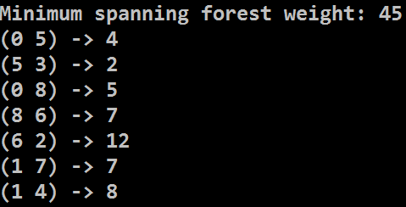
Prim's Algorithm with Adjacency Matrix
H
8
7
G
10
I
A
5
C
7
E
4
9
20
8
12
B
2
D
F
Live Demo

Slide 44
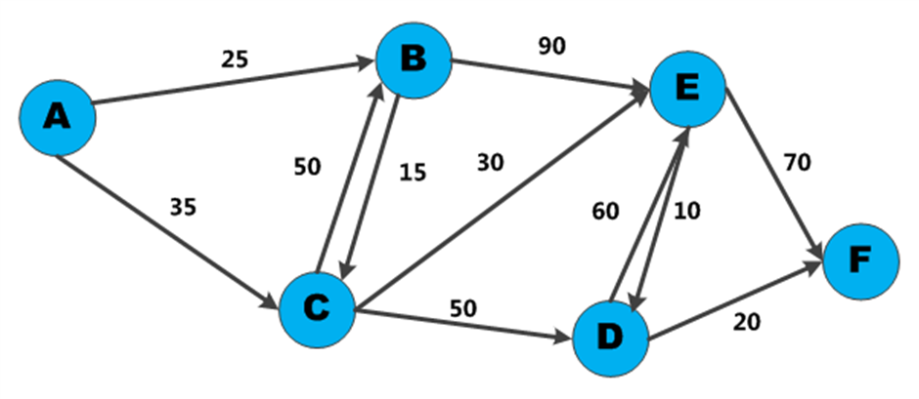

Dijkstra's Algorithm
Shortest Paths in Graph

Slide 45
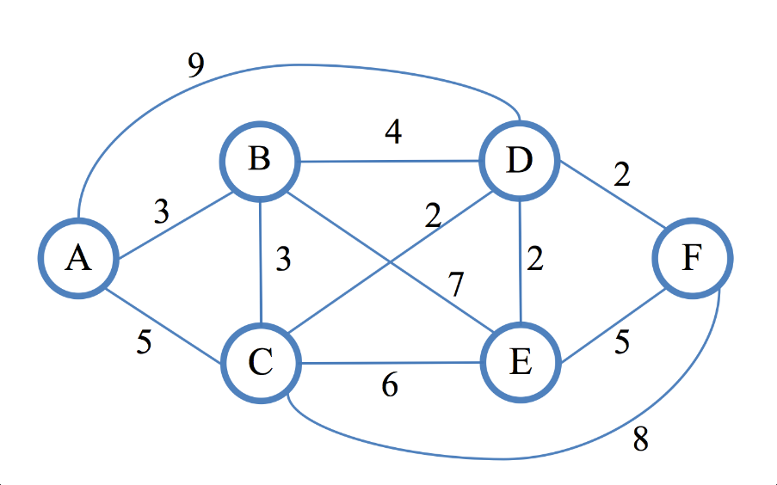
Dijkstra's Algorithm
Dijkstra's algorithm finds the shortest path from given vertex to all other vertices in a directed / undirected weighted graph
First described by Edsger W. Dijkstra in 1956
Assumptions
Weights on edges are non-negative
Edges can be directed or not
Weights do not have to be distances
Shortest path is not necessarily unique
Not all edges need to be reachable

Slide 46
Shortest Path in Unweighted Graph
In unweighted graphs finding the shortest path can be done with BFS (all edges have the same weight):
1
2
K
3
F
H
Start
E
1
2
3
I
A
J
4
D
2
2
B
4
G
C

Slide 47
Weighted Shortest Paths with BFS
In weighted graphs
Break the edges into sub-vertices and use BFS
* Too much memory usage even for smaller graphs!
A
A
5
3
B
2
C
B
C

Slide 48
Dijkstra's Algorithm
Dijskstra's algorithm is similar to BFS and to Prim's algorithms
Use a priority queue instead of queue
Keep the shortest distances so far
Steps in Dijkstra's algorithm:
v | A | B
d[v] | 30 | 15
v | A | B
d[v] | 25 | 15
Initially calculate all direct distances d[] from S
Enqueue that start node S
While (queue not empty)
Dequeue the nearest vertex B
Enqueue all unvisited child nodes of B
For each edge {B → A}, improve d[A] through B:
d[S → A] = min(d[S → A], d[S → B] + weight[B → A])
S
15
30
B
A
10

Slide 49
Dijkstra's Algorithm: Step #1
Initialize all distances d[] from s: d[0…n-1] = ∞; d[s] = 0
Enqueue the start node (0)
v | 0 | 1 | 2 | 3 | 4 | 5 | 6 | 7 | 8 | 9 | 10 | 11
d[v] | 0 | - | - | - | - | - | - | - | - | - | - | -
prev[v] | - | - | - | - | - | - | - | - | - | - | - | -
17
4
20
6
1
3
10
6
5
11
6
5
s
0
5
33
11
9
7
26
12
3
9
20
3
10
8
14
2
15
7

Slide 50
Dijkstra's Algorithm: Step #2
Dequeue the nearest vertex (0) and enqueue unvisited children: 6, 8
Improve min distances through child edges of 0: {0 → 6}, {0 → 8}
v | 0 | 1 | 2 | 3 | 4 | 5 | 6 | 7 | 8 | 9 | 10 | 11
d[v] | 0 | - | - | - | - | - | 10 | - | 12 | - | - | -
prev[v] | - | - | - | - | - | - | 0 | - | 0 | - | - | -
17
4
20
6
1
3
10
6
5
11
6
5
s
0
5
33
11
9
7
26
12
3
9
20
3
10
8
14
2
15
7

Slide 51
Dijkstra's Algorithm: Step #3
Dequeue the nearest vertex (6) and enqueue unvisited children: 4, 5
Improve min distances through child edges of 6: {6 → 4}, {6 → 5}
v | 0 | 1 | 2 | 3 | 4 | 5 | 6 | 7 | 8 | 9 | 10 | 11
d[v] | 0 | - | - | - | 27 | 16 | 10 | - | 12 | - | - | -
prev[v] | - | - | - | - | 6 | 6 | 0 | - | 0 | - | - | -
17
4
20
6
1
3
10
6
5
11
6
5
s
0
5
33
11
9
7
26
12
3
9
20
3
10
8
14
2
15
7

Slide 52
Dijkstra's Algorithm: Step #4
Dequeue the nearest vertex (8) and enqueue unvisited children: 2
Improve min distances through child edges of 8: {8 → 2}, {8 → 5}
v | 0 | 1 | 2 | 3 | 4 | 5 | 6 | 7 | 8 | 9 | 10 | 11
d[v] | 0 | - | 26 | - | 27 | 15 | 10 | - | 12 | - | - | -
prev[v] | - | - | 8 | - | 6 | 8 | 0 | - | 0 | - | - | -
17
4
20
6
1
3
10
6
5
11
6
5
s
0
5
33
11
9
7
26
12
3
9
20
3
10
8
14
2
15
7

Slide 53
Dijkstra's Algorithm: Step #5
Dequeue the nearest vertex (5) and enqueue unvisited children: 11
Improve min distances through child edges of 5: {5 → 4}, {5 → 11}
v | 0 | 1 | 2 | 3 | 4 | 5 | 6 | 7 | 8 | 9 | 10 | 11
d[v] | 0 | - | 26 | - | 20 | 15 | 10 | - | 12 | - | - | 48
prev[v] | - | - | 8 | - | 5 | 8 | 0 | - | 0 | - | - | 5
17
4
20
6
1
3
10
6
5
11
6
5
s
0
5
33
11
9
7
26
12
3
9
20
3
10
8
14
2
15
7

Slide 54
Dijkstra's Algorithm: Step #6
Dequeue the nearest vertex (4) and enqueue unvisited children: 1
Improve min distances through child edges of 4: {4 → 1}, {4 → 11}
v | 0 | 1 | 2 | 3 | 4 | 5 | 6 | 7 | 8 | 9 | 10 | 11
d[v] | 0 | 40 | 26 | - | 20 | 15 | 10 | - | 12 | - | - | 31
prev[v] | - | 4 | 8 | - | 5 | 8 | 0 | - | 0 | - | - | 4
17
4
20
6
1
3
10
6
5
11
6
5
s
0
5
33
11
9
7
26
12
3
9
20
3
10
8
14
2
15
7

Slide 55
Dijkstra's Algorithm: Step #7
Dequeue the nearest vertex (2) and enqueue unvisited children: 7
Improve min distances through child edges of 2: {2 → 7}, {2 → 11}
v | 0 | 1 | 2 | 3 | 4 | 5 | 6 | 7 | 8 | 9 | 10 | 11
d[v] | 0 | 40 | 26 | - | 20 | 15 | 10 | 41 | 12 | - | - | 31
prev[v] | - | 4 | 8 | - | 5 | 8 | 0 | 2 | 0 | - | - | 4
17
4
20
6
1
3
10
6
5
11
6
5
s
0
5
33
11
9
7
26
12
3
9
20
3
10
8
14
2
15
7

Slide 56
Dijkstra's Algorithm: Step #8
Dequeue the nearest vertex (11) and enqueue unvisited children: none
Improve min distances through child edges of 11: {11 → 1}, {11 → 7}
v | 0 | 1 | 2 | 3 | 4 | 5 | 6 | 7 | 8 | 9 | 10 | 11
d[v] | 0 | 37 | 26 | - | 20 | 15 | 10 | 41 | 12 | - | - | 31
prev[v] | - | 11 | 8 | - | 5 | 8 | 0 | 2 | 0 | - | - | 4
17
4
20
6
1
3
10
6
5
11
6
5
s
0
5
33
11
9
7
26
12
3
9
20
3
10
8
14
2
15
7

Slide 57
Dijkstra's Algorithm: Step #9
Dequeue the nearest vertex (1) and enqueue unvisited children: 9
Improve min distances through child edges of 1: {1 → 7}, {1 → 9}
v | 0 | 1 | 2 | 3 | 4 | 5 | 6 | 7 | 8 | 9 | 10 | 11
d[v] | 0 | 37 | 26 | - | 20 | 15 | 10 | 41 | 12 | 42 | - | 31
prev[v] | - | 11 | 8 | - | 5 | 8 | 0 | 2 | 0 | 1 | - | 4
17
4
20
6
1
3
10
6
5
11
6
5
s
0
5
33
11
9
7
26
12
3
9
20
3
10
8
14
2
15
7

Slide 58
Dijkstra's Algorithm: Step #10
Dequeue the nearest vertex (7) and enqueue unvisited children: none
Improve min distances through child edges of 7: {7 → 9}
v | 0 | 1 | 2 | 3 | 4 | 5 | 6 | 7 | 8 | 9 | 10 | 11
d[v] | 0 | 37 | 26 | - | 20 | 15 | 10 | 41 | 12 | 42 | - | 31
prev[v] | - | 11 | 8 | - | 5 | 8 | 0 | 2 | 0 | 1 | - | 4
17
4
20
6
1
3
10
6
5
11
6
5
s
0
5
33
11
9
7
26
12
3
9
20
3
10
8
14
2
15
7

Slide 59
Dijkstra's Algorithm: Step #11
Dequeue the nearest vertex (9) and enqueue unvisited children: none
Improve min distances through child edges of 9: none
v | 0 | 1 | 2 | 3 | 4 | 5 | 6 | 7 | 8 | 9 | 10 | 11
d[v] | 0 | 37 | 26 | - | 20 | 15 | 10 | 41 | 12 | 42 | - | 31
prev[v] | - | 11 | 8 | - | 5 | 8 | 0 | 2 | 0 | 1 | - | 4
17
4
20
6
1
3
10
6
5
11
6
5
s
0
5
33
11
9
7
26
12
3
9
20
3
10
8
14
2
15
7

Slide 60
Dijkstra's Algorithm: Step #12
The queue is empty → Dijkstra's algorithm is completed
d[v] hold shortest distances; prev[v] holds shortest paths tree edges
v | 0 | 1 | 2 | 3 | 4 | 5 | 6 | 7 | 8 | 9 | 10 | 11
d[v] | 0 | 37 | 26 | - | 20 | 15 | 10 | 41 | 12 | 42 | - | 31
prev[v] | - | 11 | 8 | - | 5 | 8 | 0 | 2 | 0 | 1 | - | 4
17
4
20
6
1
3
10
6
5
11
6
5
s
0
5
33
11
9
7
26
12
3
9
20
3
10
8
14
2
15
7

Slide 61
Dijkstra's Algorithm: Step #13
The output is the shortest paths tree from the starting node to all others
Reconstruct the path destination to source using prev[v]
v | 0 | 1 | 2 | 3 | 4 | 5 | 6 | 7 | 8 | 9 | 10 | 11
d[v] | 0 | 37 | 26 | - | 20 | 15 | 10 | 41 | 12 | 42 | - | 31
prev[v] | - | 11 | 8 | - | 5 | 8 | 0 | 2 | 0 | 1 | - | 4
prev[v] holds the shortest paths tree edges
Path[9 → 0] = {9 → 1 → 11 → 4 → 5 → 6 → 0}
4
6
1
10
5
11
6
5
0
5
11
9
12
3
8
14
15
7
2

Slide 62
Dijkstra's Algorithm – Pseudo Code
d[0…n-1] = INFINITY; d[startNode] = 0
Q = priority queue holding nodes ordered by distance d[]
startNode → Q
while (Q is not empty)
minNode = dequeue the smallest node from Q
if (d[minNode] == INFINITY) break;
foreach (child c of minNode)
if (c is unvisited) c → Q
newDistance = d[minNode] + distance {minNode → c}
if (newDistance < d[c])
d[c] = newDistance;
reorder Q;
}

Slide 63
Dijkstra's Algorithm – More Details
Modifications
Implementation with array, priority queue
Having a target node + stop when it is found
Saving the shortest paths tree (prev[v])
Complexity depends on the implementation
Typical implementation (with array): O(|V|²)
With priority queue: O((|V|+|E|)*log(|V|))
Applications – maps, GPS, networks, air travel, etc.

Slide 64
Dijkstra's Algorithm
17
4
20
6
1
3
10
6
5
11
6
5
s
0
5
33
11
9
7
26
12
3
9
20
3
10
8
14
2
15
7
Live Demo

Slide 65
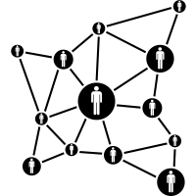
Bellman-Ford Algorithm
Shortest Path with Negative Weight Edges

Slide 66
Bellman-Ford
The Bellman-Ford algorithm finds the shortest paths from a single source to all other vertices
Unlike Dijkstra's algorithm, Bellman-Ford works with negative weight edges
Can detect negative cycles and report them
Runs in time O(|V||E|)
Uses dynamic programming
15
6
5
2
8
0
5
2
12
-5

Slide 67
Bellman-Ford: Step #1
Find shortest path from 3 to 0
Initialize distances array d[] and predecessors array prev[]
Set distance to all other vertices to ∞
15
v | 0 | 1 | 2 | 3
d[v] | ∞ | ∞ | ∞ | 0
prev[v] | - | - | - | -
3
2
1
0
2
12
-5

Slide 68
Bellman-Ford: Step #2
Iteration #1
Relax all vertices
d[0] = d[1] + -5
d[1] = d[2] + 12
d[1] = d[3] + 15 < ∞
d[2] = d[3] + 2 < ∞
d[3] = d[3] + 0
v | 0 | 1 | 2 | 3
d[v] | ∞ | 15 | 2 | 0
prev[v] | - | 3 | 3 | -
15
3
2
1
0
2
12
-5

Slide 69
Bellman-Ford: Step #3
Iteration #2
Relax all edges
d[0] = d[1] + -5 < ∞
d[1] = d[2] + 12 < 15
d[1] = d[2] + 15
d[2] = d[3] + 2
d[3] = d[3] + 0
v | 0 | 1 | 2 | 3
d[v] | 10 | 14 | 2 | 0
prev[v] | 1 | 2 | 3 | -
15
3
2
1
0
2
12
-5

Slide 70
Bellman-Ford: Step #4
Iteration #3
Relax all edges
d[0] = d[1] + -5 < 10
d[1] = d[2] + 12
d[1] = d[2] + 15
d[2] = d[3] + 2
d[3] = d[3] + 0
v | 0 | 1 | 2 | 3
d[v] | 9 | 14 | 2 | 0
prev[v] | 1 | 2 | 3 | -
15
3
2
1
0
2
12
-5

Slide 71
Bellman-Ford: Step #5
|V|-1 iterations complete
Relax all edges one last time
d[0] = d[1] + -5
d[1] = d[2] + 12
d[1] = d[2] + 15
d[2] = d[3] + 2
d[3] = d[3] + 0
No edges were relaxed → no negative weight cycles exist
v | 0 | 1 | 2 | 3
d[v] | 9 | 14 | 2 | 0
prev[v] | 1 | 2 | 3 | -
15
3
2
1
0
2
12
-5

Slide 72
Bellman-Ford Algorithm – Pseudo Code
// Step 1: initialize distance and predecessor arrays
for each vertex v in vertices:
distance[v] = ∞
predecessor[v] = null
distance[source] = 0
// Step 2: relax edges repeatedly
for i from 1 to count(vertices) - 1
for each edge (u, v) with weight w in edges:
if distance[u] + w < distance[v]
distance[v] = distance[u] + w
predecessor[v] = u
(example continues)

Slide 73
Bellman-Ford Algorithm – Pseudo Code (2)
After |V|-1 walks, check if a shorter path still exists
If there is such a path → there is a negative weight cycle
// Step 3: check for negative-weight cycles
for each edge (u, v) with weight w in edges
if distance[u] + w < distance[v]
error "Graph contains a negative-weight cycle"
1
6
10
5
Every next walk will discover a cheaper path
-7
0
3
8
2
12
14

Slide 74
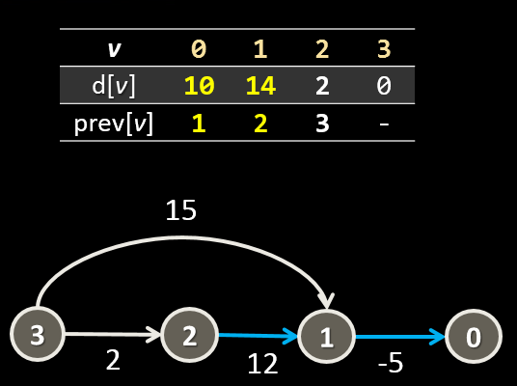
Bellman-Ford Algorithm
Live Demo

Slide 75

Floyd-Warshall Algorithm
4
0
-2
1
3
2
-1
3
2
Shortest Paths Between All Pairs

Slide 76
Floyd-Warshall
The Floyd-Warshall algorithm computes the shortest paths between all pairs of vertices
Edge weights can be positive or negative
Can be extended to detect negative weight cycles
Has running time of O(|V|³)
Performs better than running Bellman-Ford for each vertex
Also uses dynamic programming

Slide 77
Floyd-Warshall Algorithm
For each vertex k from the graph
Update all shortest paths between vertices i and j where k is an intermediate vertex
There are two cases:
k does not lie in the path between i and j → shortest path does not change
k lies on the path → dist[i][j] = dist[i][k] + dist[k][j] if the path through k is shorter
k₁
k₂
k₃
i
j
All intermediate vertices in the path i..j

Slide 78
Floyd-Warshall Algorithm – Pseudo Code
var V = |V| - 1;
var dist[V][V]
for each vertex v
dist[v][v] = 0
for each edge (u,v)
dist[u][v] = weight(u, v)
for k from 0 to V
for i from 0 to V
for j from 0 to V
if (dist[i][k] + dist[k][j] < dist[i][j])
dist[i][j] = dist[i][k] + dist[k][j]
4
0
-2
1
3
2
-1
3
2

Slide 79

Floyd-Warshall Algorithm
Live Demo

Slide 80

Summary
Minimum spanning tree (MST)
Solved by Prim's and Kruskal's algorithms
Shortest paths in a graph:
Dijkstra's algorithm
Bellman-Ford
Floyd Warshall

Slide 81









Advanced Graph Algorithms
https://softuni.bg/trainings/1331/algorithms-april-2016

Slide 82
License
This course (slides, examples, labs, videos, homework, etc.) is licensed under the "Creative Commons Attribution-NonCommercial-ShareAlike 4.0 International" license
Attribution: this work may contain portions from
"Fundamentals of Computer Programming with C#" book by Svetlin Nakov & Co. under CC-BY-SA license
"Data Structures and Algorithms" course by Telerik Academy under CC-BY-NC-SA license

Slide 83





Free Trainings @ Software University
Software University Foundation – softuni.org
Software University – High-Quality Education, Profession and Job for Software Developers
softuni.bg
Software University @ Facebook
facebook.com/SoftwareUniversity
Software University @ YouTube
youtube.com/SoftwareUniversity
Software University Forums – forum.softuni.bg

